Slide 1

Programming Trends
Lucky Chav
November 11, 2021

Slide 2

OUTLINE
Executive Summary
Introduction
Methodology
Results
Visualization – Charts
Dashboard
Discussion
Findings & Implications
Conclusion
Appendix

Slide 3

EXECUTIVE SUMMARY
Javascript, HTML/CSS, SQL, and Python are roughly the top in Programming Languages.
MySQL remains in the top Databases, while PostgreSQL and MongoDB are trending for next year.
Platforms as Web Frames tend to stay roughly the same for next year
Overall demographics of respondents tend to be a male around the ages of 20-45.
More than a quarter of respondents are from the United States (~27%).

Slide 4

INTRODUCTION
In order to keep pace with changing technologies and remain competitive, our organization regularly analyzes data to help identify future skill requirements. As a Data Analyst, my task is to collect data from various sources and identify trends for this year's report on emerging skills.
First, I collected the top programming skills that are most in demand from various sources including:
Job postings
Training portals
Surveys
Once enough data was collected, I began analyzing the data and identify insights and trends that may include the following:
What are the top programming languages in demand?
What are the top database skills in demand?
What are the popular IDEs?

Slide 5

METHODOLOGY
The dataset used in this report comes a modified subset from the following source: https://stackoverflow.blog/2019/04/09/the-2019-stack-overflow-developer-survey-results-are-in/ under a ODbL: Open Database License.
The data was made ready for analysis using data wrangling techniques.
When the data was ready, statistical techniques were applied to analyze the data.
All of the information was then brought together by using IBM Cognos Analytics to create a dashboard.

Slide 6
RESULTS

Slide 7
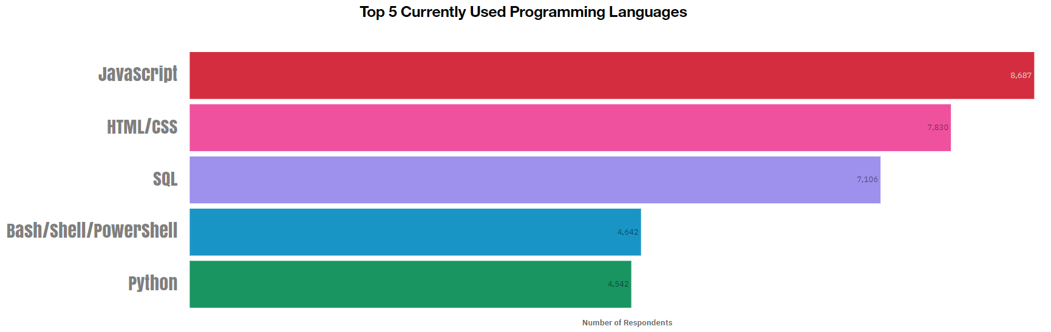
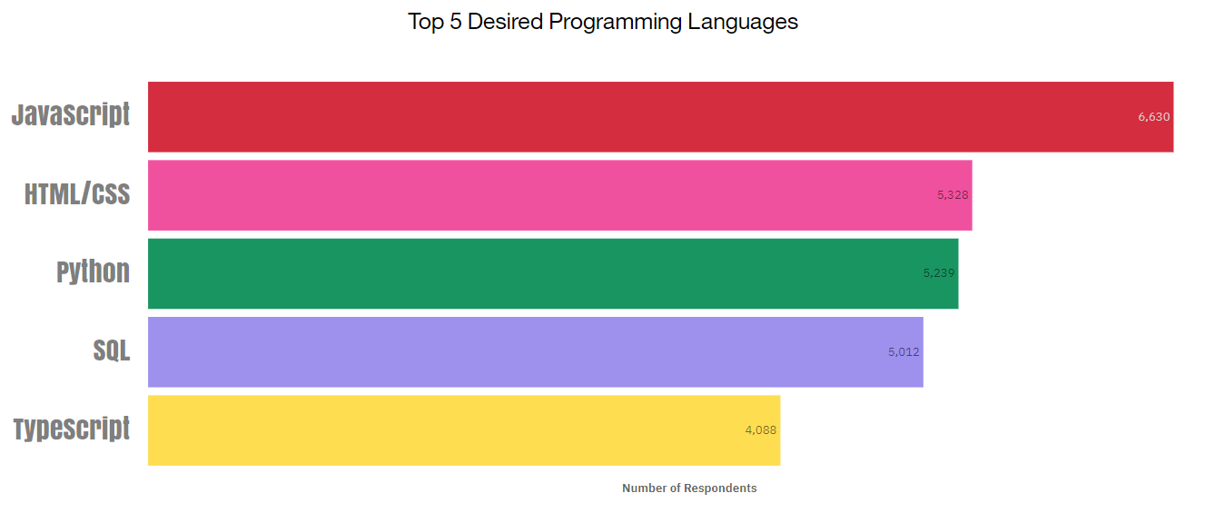
PROGRAMMING LANGUAGE TRENDS
Current Year
Next Year

Slide 8
PROGRAMMING LANGUAGE TRENDS - FINDINGS & IMPLICATIONS
Findings
Javascript is the currently the most popularly used and desired programming language,
HTML/CSS is currently the second most popular and desired programming language.
While python is currently the 5th used programming language, is it also the 3rd most desired for next year.
While Bash/Shell/Powershell is in the top 5 currently used languages, it is not in the top 5 for desired languages for next year.
Implications
Javascript shall remain as the top in popularity
HTML/CSS shall remain second as well
Python is currently in the top 5 currently used programming languages and is gaining popularity for next year.
Typescript is in the top 5 desired programming languages, which might replace Bash/Shell/Powershell.

Slide 9
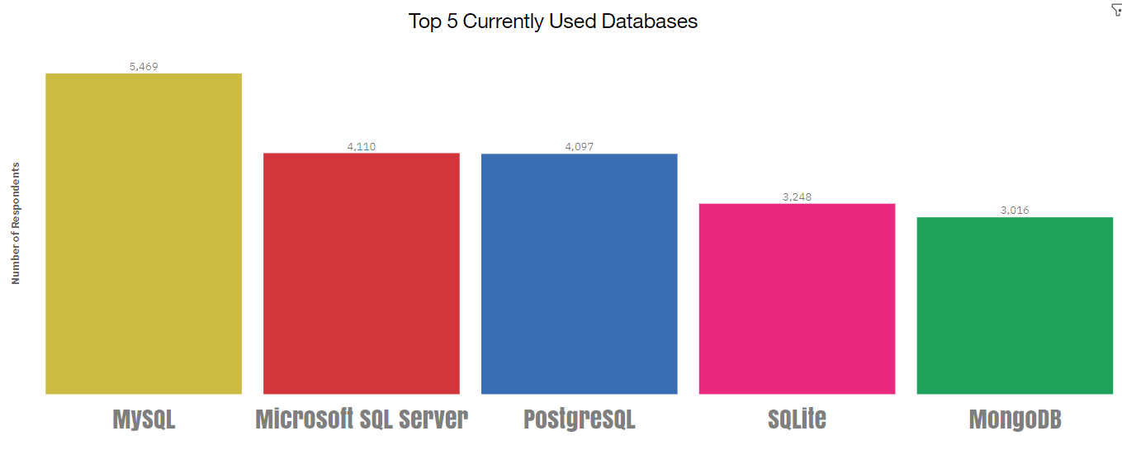
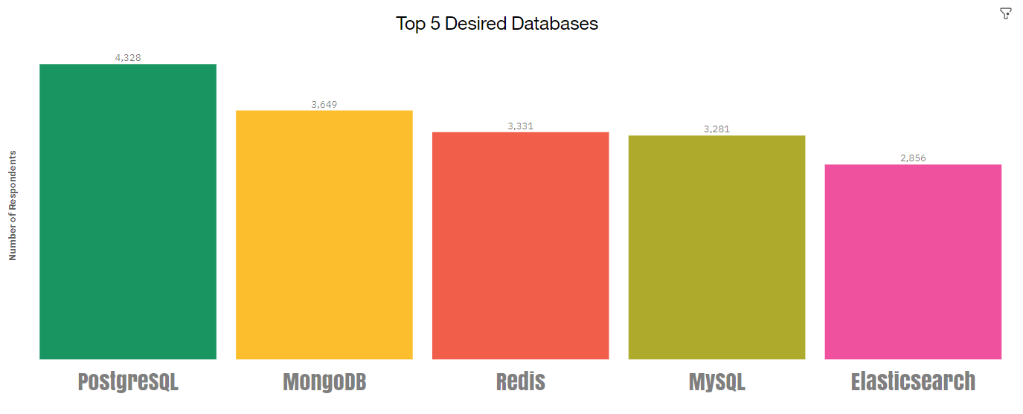
DATABASE TRENDS
Current Year
Next Year

Slide 10
DATABASE TRENDS - FINDINGS & IMPLICATIONS
Findings
The currently most used database is MySQL.
MySQL remains in the top 5 most desired databases for next year.
PostgreSQL is the most desired database for next year, and is currently in the top 5 databases used.
While MongoDB is currently the 5th most used database, it is the 2nd most desired database for next year.
Implications
PostgreSQL is trending for next year
MongoDB is also trending next year
While MySQL is currently the most used, it might still be in the top 5 for next year
Microsoft SQL Server and SQLite might not be in top 5 next year

Slide 11

DASHBOARD
https://dataplatform.cloud.ibm.com/dashboards/6f83206d-bf7d-4934-a61d-6337eb3871f2/view/611dd8023e903fde49c2eae407912501783e765ab6bb8201d4807b495a657397a83c1494c87b4e588b120037fbbd115bcb

Slide 12
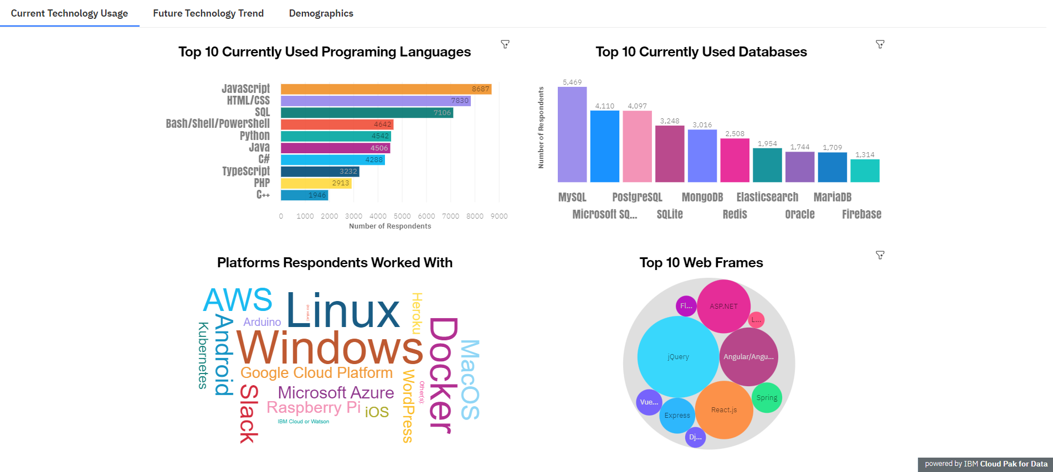
DASHBOARD TAB 1

Slide 13
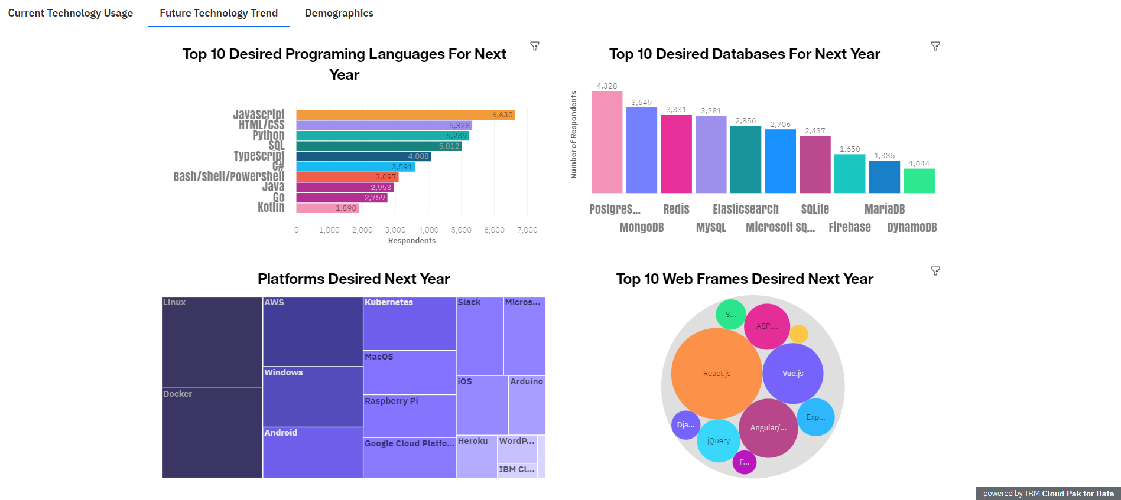
DASHBOARD TAB 2

Slide 14
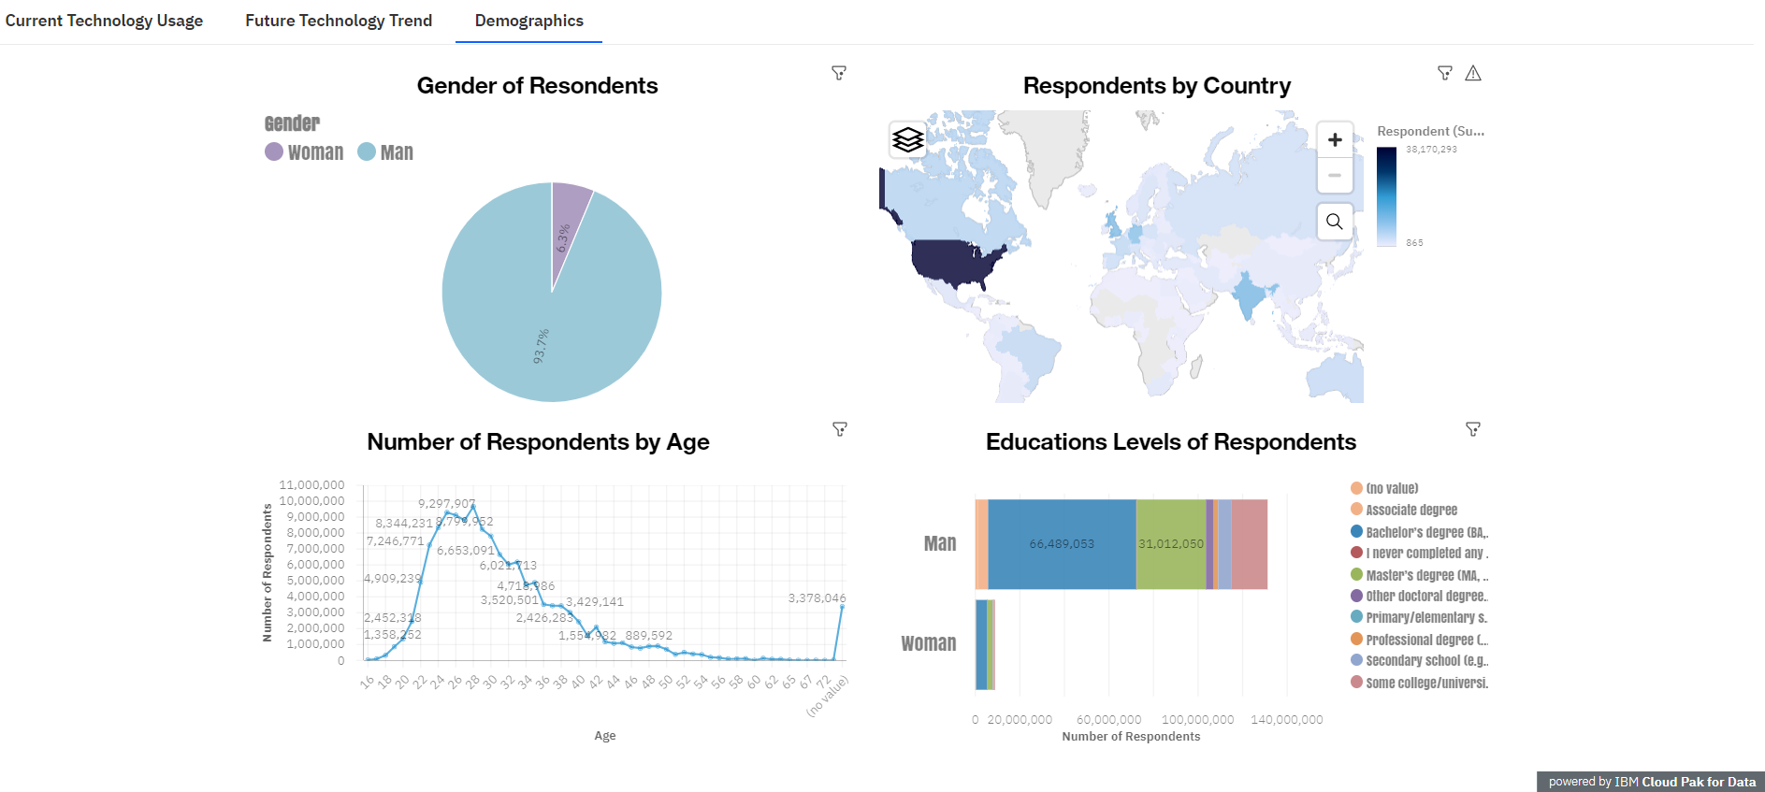
DASHBOARD TAB 3

Slide 15
DISCUSSION
Can u tell what the majority demographics of respondents were?
Compared to Programming Languages, do we see any trends for Platforms, and Web Frames?

Slide 16
OVERALL FINDINGS & IMPLICATIONS
Findings
Most, but not all of the currently used technology remain at the top as the most desired languages
Most respondents tend to be around ages 20 - 45
~93.7% of respondents were male.
More than a quarter are from the United States (~27%).
Implications
While most programming languages, databases, platforms, and web frames are currently used, they may not be the most desired for next year
Overall demographics of respondents tend to be around ages 20 - 45
Respondents mostly male (~93.7%)
Majority of respondents, roughly more than a quarter are from the United States (~27%).

Slide 17

CONCLUSION
Javascript, HTML/CSS, and SQL remain as the top in Programming Languages with Python gaining more popularity for next year.
MySQL remains in the top Databases, while PostgreSQL and MongoDB are trending for next year.
There’s not much change in terms of Platforms and Web Frames as the top 5 currently used tend to stay the same for most desired for next year.
The majority demographics of the industry tend to be a male around the ages of 20-45.

Slide 18
RECOMMENDATIONS
In order to keep pace with changing technologies and remain competitive, our organization should adopt the trending programming language, Python.
We should also implement a strategy in incorporate the PostgreSQL and MongoDB
We can conduct another survey bi-annually to the target audience, males roughly the ages 20-45, to see how progress is.

Slide 19
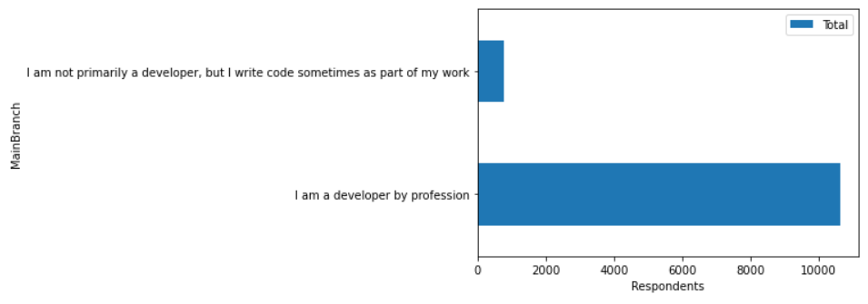
APPENDIX
Majority of Respondents tend to be a developer by profession

Slide 20
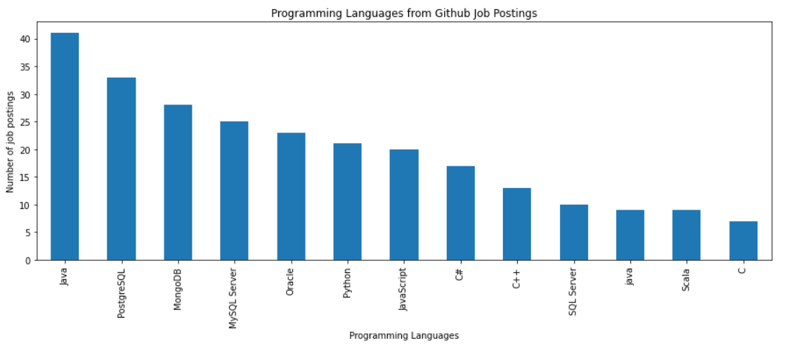
GITHUB JOB POSTINGS

Slide 21
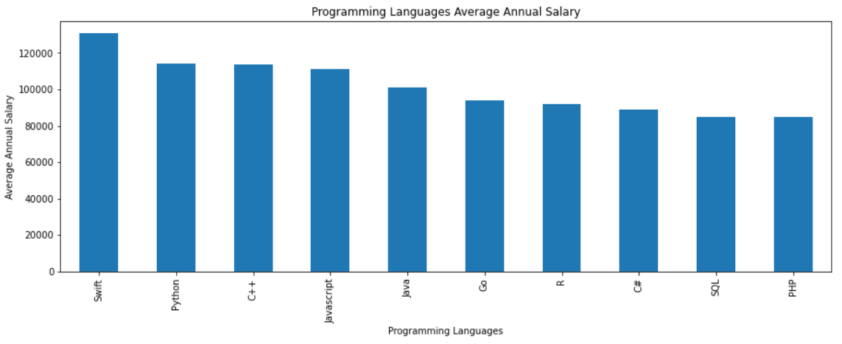
POPULAR LANGUAGES

